Slide 1
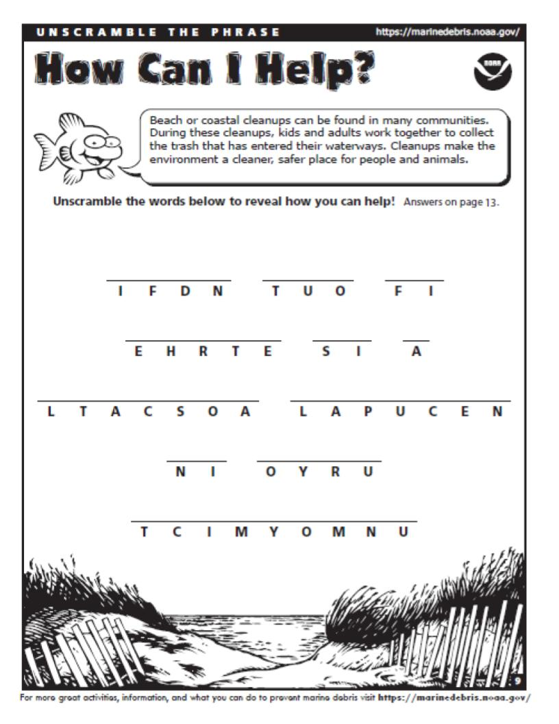
Write answer here
Write answer here
Write answer here
Write answer here
Write answer here
Write answer here
Write answer here
Write answer here
Write answer here
Write answer here
Write answer here
Notes:
Document for turning template into worksheet

