Slide 1
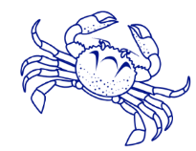
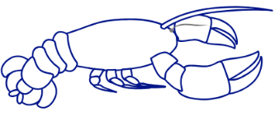
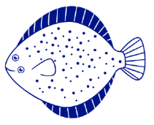
SoundWaters Distance Learning Human Impacts
Humans are dependent on all earth systems, which are connected. Discover the positive and negative effects that result from our use of the environment and ways we can mitigate these changes.
Lesson Modules
• Earth Systems
• Marine Debris
• Microplastics
• Water Movement
• Resource Management

Slide 2
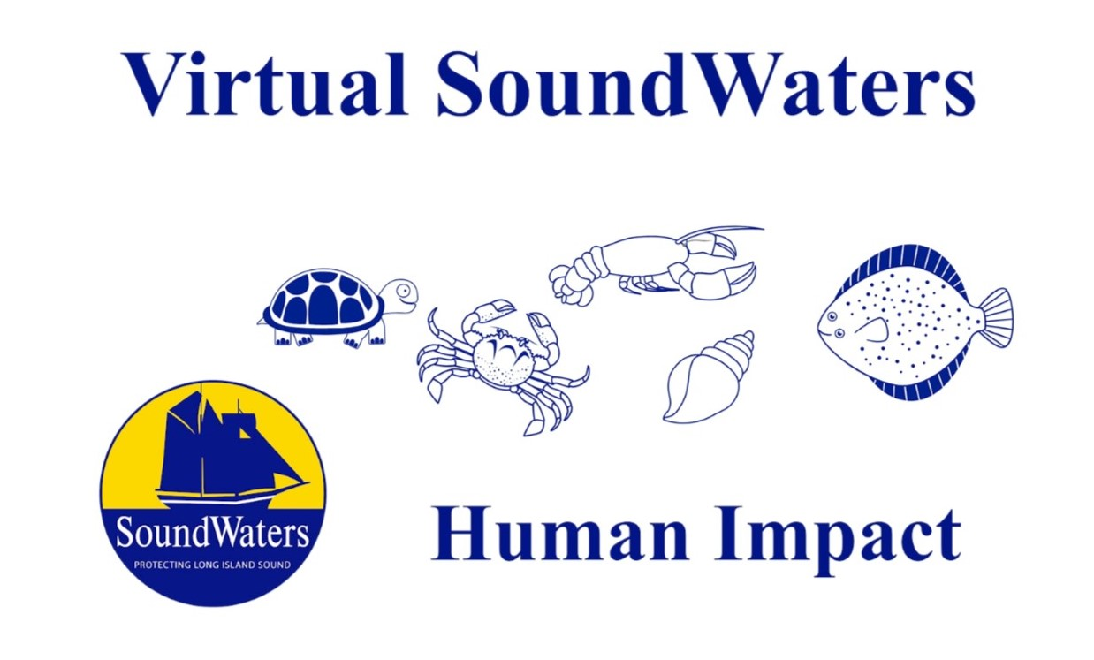
Lesson 1: Earth Systems Overview
In this video you will learn all about adaptations. This video will be a kickoff to learning animal adaptations all week long.
https://youtu.be/B1P5mqloys8

Slide 4
Earth Systems - Vocabulary Words
Hydrosphere: All the waters on the earth's surface, such as lakes and seas, and sometimes including water over the earth's surface, such as clouds.
Water cycle: The water cycle describes how water evaporates from the surface of the earth, rises into the atmosphere, cools and condenses into rain or snow in clouds, and falls again to the surface as precipitation.
Brackish: A type of water that is a combination of fresh and saltwater.
Geosphere: The portion of earth that includes the earth's interior and all landforms on the surface of the earth.
Atmosphere: The layer of gasses surrounding the earth
Oxygen: One of the gasses in the atmosphere that is used by living organisms to breathe
Biosphere: All the living organisms on the earth
Invasive species: An organism that is not native to an area and causes harm
Practice the vocabulary words on quizlet: https://quizlet.com/_8ax02l?x=1jqt&i=2s8evl

Slide 5
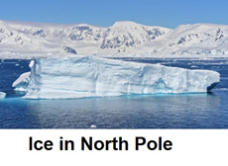
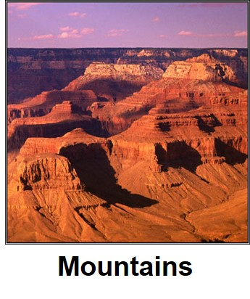
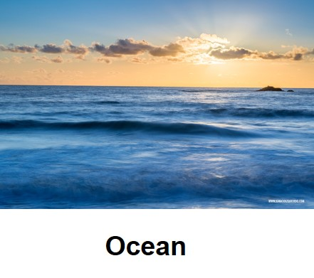
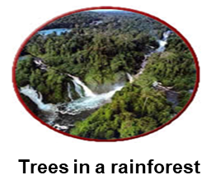
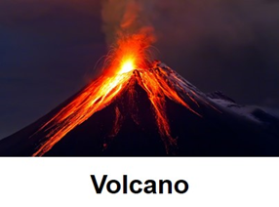
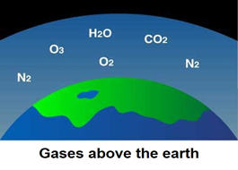
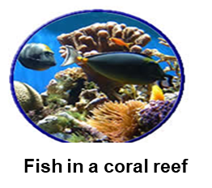
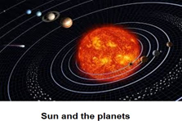

Slide 7
Test Your Knowledge - Earth Systems Quiz
How many earth systems are there?
1
2
3
4
Take the quiz online:
https://forms.gle/7fPF4ZdYkqT3QJGD8

Slide 8
Test Your Knowledge - Earth Systems Quiz
True or False: The earth systems do not have an effect on each other.
True
False
Take the quiz online:
https://forms.gle/7fPF4ZdYkqT3QJGD8

Slide 9
Test Your Knowledge - Earth Systems Quiz
The ______________ earth system is made up of all the bodies of water on earth.
Geosphere
Atmosphere
Hydrosphere
Biosphere
Take the quiz online:
https://forms.gle/7fPF4ZdYkqT3QJGD8

Slide 10
Test Your Knowledge - Earth Systems Quiz
Developing an area of land by removing dirt and putting in a road is an example of changing which earth system?
Geosphere
Atmosphere
Hydrosphere
Biosphere
Take the quiz online:
https://forms.gle/7fPF4ZdYkqT3QJGD8

Slide 11
Test Your Knowledge -Earth Systems Quiz
Which of these materials is NOT part of the atmosphere?
Trees
Clouds
Oxygen
Take the quiz online:
https://forms.gle/7fPF4ZdYkqT3QJGD8

Slide 12
Test Your Knowledge - Earth Systems Quiz
The ozone is found in which earth system?
Geosphere
Atmosphere
Hydrosphere
Biosphere
Take the quiz online:
https://forms.gle/7fPF4ZdYkqT3QJGD8

Slide 13
Test Your Knowledge - Earth Systems Quiz
Fresh water is important for life on earth because
All living things need it or they will not survive
The biosphere needs water
We need water to grow food
All of the above
Take the quiz online:
https://forms.gle/7fPF4ZdYkqT3QJGD8

Slide 14
Learn More - Earth Systems
Humans have been impacting Earth for thousands of years, study says https://www.cnn.com/2019/08/29/world/human-impact-earth-scn/index.html
Water Cycle |Generation Genius
https://www.generationgenius.com/videolessons/water-cycle-video-for-kids/
Learn About Planet Earth - Earth's Atmosphere
https://youtu.be/fyfN9t_E0w8
Geosphere, Biosphere, Hydrosphere, Atmosphere
https://youtu.be/HurK-1rrdb8

Slide 15
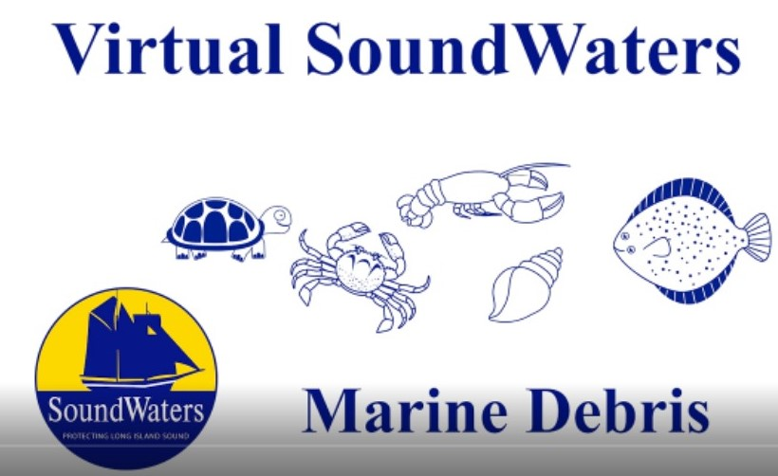
Lesson 2: Marine Debris
In this video, you will be learning about marine debris and how it affects the animals in Long Island Sound.
https://youtu.be/Wcg2liDSvs0

Slide 17
Marine Debris - Vocabulary Words
Pollution: Something that is introduced to the environment that is dirty, unclean or has a harmful effect
Current: When a body of water or air is moving in a certain direction
Food Chain: The order in which organisms, or living things, depend on each other for food
Decompose: To break down into basic elements
Marine: Found in or produced by the ocean
Debris: Trash, scattered pieces of waste.
Ocean: The body of salt water that covers nearly ¾ of the surface of the earth
Plastic: An artificial substance made from oil and chemicals that can be easily shaped when soft. Plastic is formed into many materials and products.
Litter: Trash such as plastic, paper, cans, and bottles that are left in a public space
Practice the vocabulary words on quizlet: https://quizlet.com/_8bhp62?x=1jqt&i=2s8evl

Slide 19
Test Your Knowledge - Marine Debris Quiz
What is an example of marine debris?
Algae
Crab molt
Balloon
Plankton
Take the quiz online:
https://forms.gle/FQEJoPXXWz1cr6Wn8

Slide 20
Test Your Knowledge - Marine Debris Quiz
Where does most of the marine debris in Long Island Sound come from?
By the animals that live there
Thrown overboard by boats
Floats or blown into the water by land
Take the quiz online:
https://forms.gle/FQEJoPXXWz1cr6Wn8

Slide 21
Test Your Knowledge - Marine Debris Quiz
Why do animals eat plastic?
They like the taste
Because it is easier than hunting
They mistake it for real food
Take the quiz online:
https://forms.gle/FQEJoPXXWz1cr6Wn8

Slide 22
Test Your Knowledge - Marine Debris Quiz
In what ways can plastic in the water harm humans?
If we eat fish that have eaten plastic
We can get tangled in it while swimming
Can damage our property- such as boats
All of the above
Take the quiz online:
https://forms.gle/FQEJoPXXWz1cr6Wn8

Slide 23
Test Your Knowledge - Marine Debris Quiz
True or False: When plastic gets put into the water
it stays in the same spot.
True
False
Take the quiz online:
https://forms.gle/FQEJoPXXWz1cr6Wn8

Slide 24
Test Your Knowledge - Marine Debris Quiz
What causes plastic to break down?
Sun, wind, waves, animals eating it
Animals only
Waves only
It doesn't break down
Take the quiz online:
https://forms.gle/FQEJoPXXWz1cr6Wn8

Slide 25
Learn More - Marine Debris
Print your own Marine Debris Bookmark
https://marinedebris.noaa.gov/sites/default/files/publications-files/Did_You_Know_Marine_Debris_Bookmark_Series.pdf
Marine Debris Tracker App
https://marinedebris.noaa.gov/partnerships/marine-debris-tracker
Become part of the EPA’s Planet Protector Club!
https://www.epa.gov/students/planet-protectors-activities-kids
Understanding Marine Debris: Games and Activities for Kids of All Ages
https://marinedebris.noaa.gov/understanding-marine-debris-games-and-activities-kids-all-ages

Slide 26
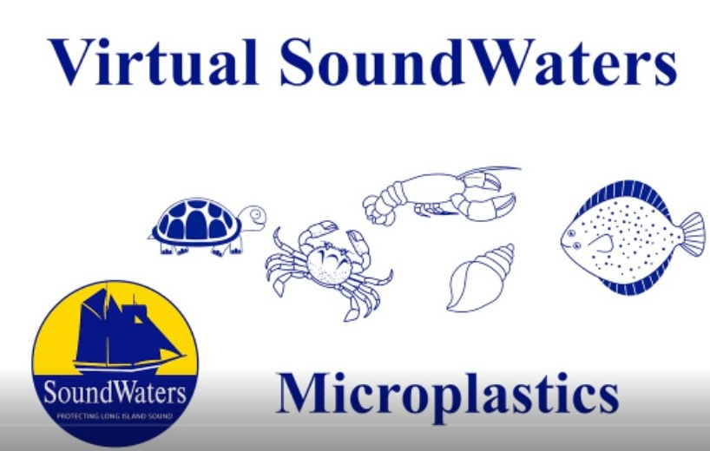
Lesson 3: Microplastics
In this video you will be learning about a type of
pollution known as microplastics.
https://youtu.be/WKDX221dEn4

Slide 28
Microplastics- Vocabulary Words
Pollution: When the environment is contaminated, or dirtied, by harmful substances
Microplastic: Pieces of plastic that are smaller than 5 millimeters in size. They come from a variety of sources
Degrade: To break down into something smaller
Microbead: An extremely small piece of plastic used in products such as toothpaste and face wash
Microfiber: The tiny fibers that make up polyester clothing. Most clothing uses microfibers
Water treatment plant: A facility that treats water from houses to remove contaminants
Practice the vocabulary words on quizlet: https://quizlet.com/_8awzch?x=1jqt&i=2s8evl

Slide 30
Test Your Knowledge - Microplastics Quiz
Microplastics can come from a bunch of different places. Which of the following is not one of the places we mentioned in the video?
A plastic bottle breaking down in the environment.
Microfibers from our laundry washing down the drain.
Microbeads coming down from the sky with the rain.
Discarded fishing line breaking down into smaller pieces.
Take the quiz online:
https://forms.gle/79zB1Kxd38f1emNY7

Slide 31
Test Your Knowledge - Microplastics Quiz
Which of the following can cause a large piece of plastic marine debris to break down in the environment?
The sun
The crashing of the waves
People crumpling up the trash
Both a and b
Take the quiz online:
https://forms.gle/79zB1Kxd38f1emNY7

Slide 32
Test Your Knowledge - Microplastics Quiz
True or False: Microplastics are bad for the environment.
True
False
Take the quiz online:
https://forms.gle/79zB1Kxd38f1emNY7

Slide 33
Test Your Knowledge - Microplastics Quiz
President Obama passed a law banning companies from using ____________ in rinse-off cosmetic products.
Natural exfoliants
Microbeads
Apricot shells
Take the quiz online:
https://forms.gle/79zB1Kxd38f1emNY7

Slide 34
Test Your Knowledge - Microplastics Quiz
A microplastic is a piece of plastic that is ___________ millimeters in length, as small as an ant!
3mm
4mm
5mm
6mm
Take the quiz online:
https://forms.gle/79zB1Kxd38f1emNY7

Slide 35
Test Your Knowledge - Microplastics Quiz
Microplastics are often eaten by animals in the ecosystem. These microplastics are bad for the animals because
The microplastics can absorb chemicals in the water and bring those chemicals into the animals that eat them.
The microplastics don’t give the animal any energy.
The microplastics make the animal think it is full when it doesn’t actually have any food in it’s stomach.
All of the above.
Take the quiz online:
https://forms.gle/79zB1Kxd38f1emNY7

Slide 36
Make a Public Service Announcement
A Public Service Announcement (PSA) is a way to inform people and tell them why they should do or not do something. Below are links for examples of a PSA video and a PSA poster.
Use the PSA worksheet to make your own PSA to inform people about microplastics! You can use words or pictures.
PSA Examples
https://sbt.blob.core.windows.net/site-images/create/infographics/psa-example.png
https://youtu.be/l1ahuBI4QFU

Slide 37
PSA TITLE
What is the issue or problem you are talking about?
Who or what does the issue affect?
The environment, people, animals
How can people fix or help with the issue

Slide 38
Learn More - Microplastics
What are microplastics?
https://oceanservice.noaa.gov/facts/microplastics.html
Understanding Microplastics In Seafood
https://blog.marinedebris.noaa.gov/understanding-microplastics-seafood
Microplastics explained (explainity® explainer video)
https://youtu.be/49OJoTsZYO0
Ocean Confetti, the challenge of micro-plastics
https://thekidshouldseethis.com/post/ocean-confetti-microplastics
How to discover hidden microplastics!
https://youtu.be/Hh1cGaVZL2s
Microplastic Marine Debris Fact Sheet
https://marinedebris.noaa.gov/sites/default/files/Microplastic%20Marine%20Debris%20Fact%20Sheet.pdf
Elementary school students build machine to pull tiny pieces of plastic from sand
https://www.nbc12.com/2019/09/04/elementary-school-students-build-machine-pull-tiny-pieces-plastic-sand/
Laundry ball that catches all those nasty microfibers
https://youtu.be/P_6EpIW2Ew4

Slide 39
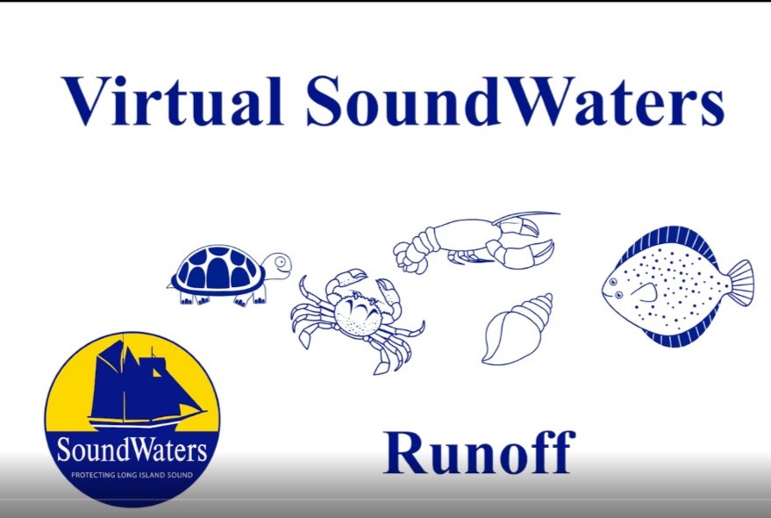
Lesson 4: Runoff
In this video, you will be learning about runoff
and how it affects Long Island Sound.
https://youtu.be/_bvLbaPSEaw

Slide 41
Runoff- Vocabulary Words
Runoff: Draining away of water from land
Fertilizer: A chemical that helps plants to grow
Wastewater Treatment Plant: A place where the water from houses and goes to be cleaned so it can be reused
Oxygen: A part of the air that we need to breathe. Oxygen is the most abundant element on earth.
Storm Drain: An opening in a sidewalk, street, or parking lot that carries water away from those areas and drains into a nearby waterway
Practice the vocabulary words on quizlet: https://quizlet.com/_8bhy7u?x=1jqt&i=2s8evl

Slide 43
Test Your Knowledge - Runoff Quiz
What is a runoff?
A puddle
Land filtering water
The draining away of water from land
None of the above
Take the quiz online:
https://forms.gle/mB4MWoYSiCivBh6MA

Slide 44
Test Your Knowledge - Runoff Quiz
Where does most runoff in Connecticut go?
Our homes
Long Island Sound
To other states
Take the quiz online:
https://forms.gle/mB4MWoYSiCivBh6MA

Slide 45
Test Your Knowledge - Runoff Quiz
Why can runoff be harmful to the environment?
It is actually not harmful at all
It can flood your home
As it travels over land it can pick up chemicals and debris
Take the quiz online:
https://forms.gle/mB4MWoYSiCivBh6MA

Slide 46
Test Your Knowledge - Runoff Quiz
Which location in the video added the highest amount of fertilizer to the water?
Lawns
Water Treatment Center
The Mill River
None of the above
Take the quiz online:
https://forms.gle/mB4MWoYSiCivBh6MA

Slide 47
Test Your Knowledge - Runoff Quiz
True or False: Runoff can affect the Long Island Sound Food Chain.
True
False
Take the quiz online:
https://forms.gle/mB4MWoYSiCivBh6MA

Slide 48
Test Your Knowledge - Runoff Quiz
True or False: A rain garden helps prevent runoff.
True
False
Take the quiz online:
https://forms.gle/mB4MWoYSiCivBh6MA

Slide 49
Learn More - Runoff
Ever wonder where the rain goes?
https://youtu.be/LMq6FYiF1mo
Learn more about stormwater runoff
https://youtu.be/jNs28UcjNbk
Lets start thinking about runoff near your house. Use this activity to take a walk around your house and observe and record things like a scientist would! https://water.unl.edu/documents/Stormwater%20Walk%20opt.pdf

Slide 50
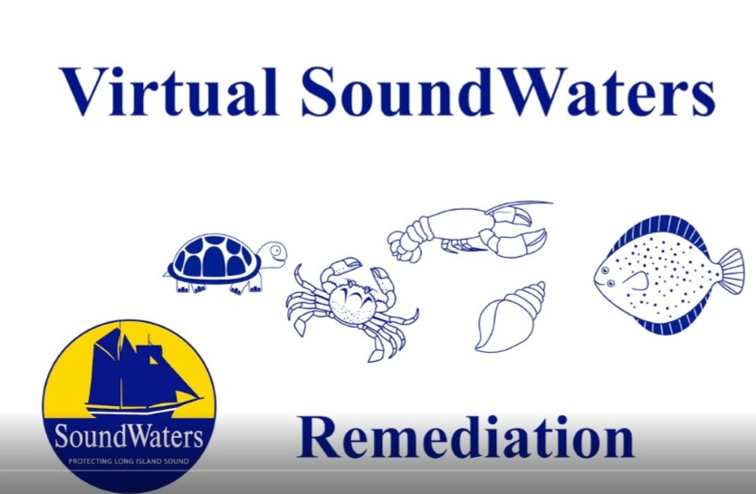
Lesson 5: Remediation
Watch this video to discover how to combat human impact.
https://youtu.be/xkMeiK0fYwA

Slide 52
Remediation - Vocabulary Words
Human Impact: Changes to the environment caused directly or indirectly by humans.
Great Pacific Garbage Patch: A floating island of plastic found in the middle of the Pacific Ocean.
Recycling: The process of collecting and processing materials that would otherwise be thrown away as trash and turning them into new products.
Single stream recycling: Recycling system that involves recyclables of all kinds being placed in a single curbside bin by community members. The recyclables are collected and transported to a material recovery facility where they are sorted and processed.
Composting: The breakdown of organic materials (leaves, grass, food scraps) by organisms to release the nutrients back into the environment.
Marina Trash Skimmer: Device that collects debris from the marina, allowing for us to remove the debris before it makes its way into Long Island Sound.
Kelp: A type of seaweed grown in saltwater. It is used by people as food and to fertilize gardens. It is great at removing the extra nutrients in the water caused by runoff.
Practice the vocabulary words on quizlet: https://quizlet.com/_8b1u4i?x=1jqt&i=2s8evl

Slide 53
Test Your Knowledge - Remediation Quiz
What is the Great Pacific Garbage Patch?
A large coral reef found in the Pacific Ocean.
A floating mass of plastic and marine debris in the Pacific Ocean.
The largest whale species ever discovered.
A bunch of marine debris found in the Atlantic Ocean.
Take the quiz online:
https://forms.gle/69p9yVfTAEorHqyt8

Slide 54
Test Your Knowledge - Remediation Quiz
Kelp is a type of seaweed grown in the water to use as food for humans and animals as well as to fertilize gardens. What benefit does the kelp provide to Long Island Sound as it grows?
Kelp adds Nitrogen into the water.
It removes excess Nitrogen from the water.
Kelp removes oxygen from the water.
It eats plankton.
Take the quiz online:
https://forms.gle/69p9yVfTAEorHqyt8

Slide 55
Test Your Knowledge - Remediation Quiz
True or False: Correctly composted material can be added to soil to help add nutrients to the soil and help plants grow.
True
False
Take the quiz online:
https://forms.gle/69p9yVfTAEorHqyt8

Slide 56
Test Your Knowledge - Remediation Quiz
The marina trash skimmer is a tool SoundWaters utilizes to
Collect debris from the land and prevent it from entering the water.
Perform a population study on the species of fish present in Stamford Harbor.
Prevent trash from entering Long Island Sound by collecting the debris floating in the marina.
Remove the species of crabs that are not native to Long Island Sound.
Take the quiz online:
https://forms.gle/69p9yVfTAEorHqyt8

Slide 57
Test Your Knowledge - Remediation Quiz
The marina trash skimmer is a tool SoundWaters utilizes to
Collect debris from the land and prevent it from entering the water.
Perform a population study on the species of fish present in Stamford Harbor.
Prevent trash from entering Long Island Sound by collecting the debris floating in the marina.
Remove the species of crabs that are not native to Long Island Sound.
Take the quiz online:
https://forms.gle/69p9yVfTAEorHqyt8

Slide 58
Test Your Knowledge - Remediation Quiz
True or False: My actions everyday DO NOT have an impact on the health of Long Island Sound.
True
False
Take the quiz online:
https://forms.gle/69p9yVfTAEorHqyt8

Slide 61
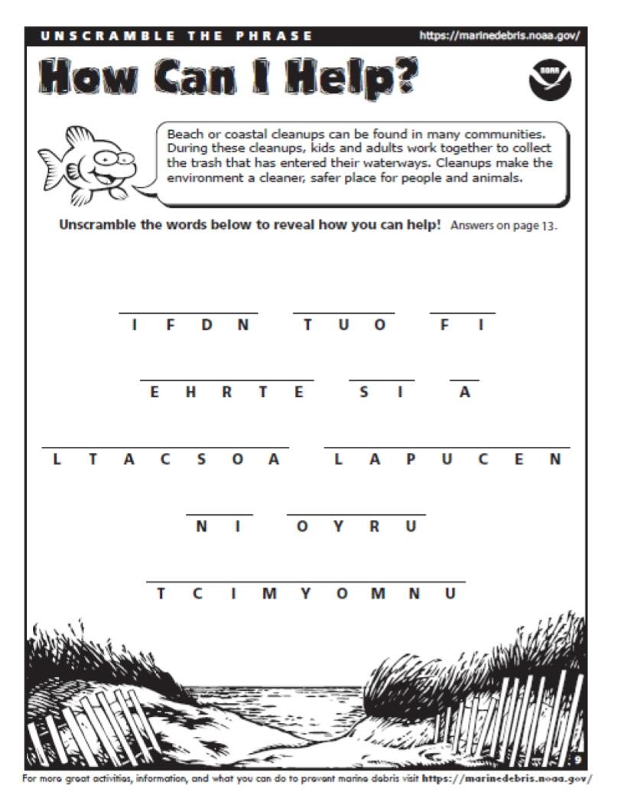

Slide 62
Learn More - Remediation
Not sure how your town recycles? Check out this link to find out! https://berecycled.org/
Want to learn more about recycling, composting and the trash skimmer?
Making a Homemade Composter! | Full-Time Kid | PBS Parents
https://youtu.be/kA3q07paNbE
Learn How to Compost For Beginners | Georgia-Pacific
https://youtu.be/-1lPTfdb8bI
How it Works: Single Stream Recycling
https://youtu.be/hdGjiKJsgRk
What is the trash skimmer?
https://soundwaters.org/trash-skimmer/

