Slide 1
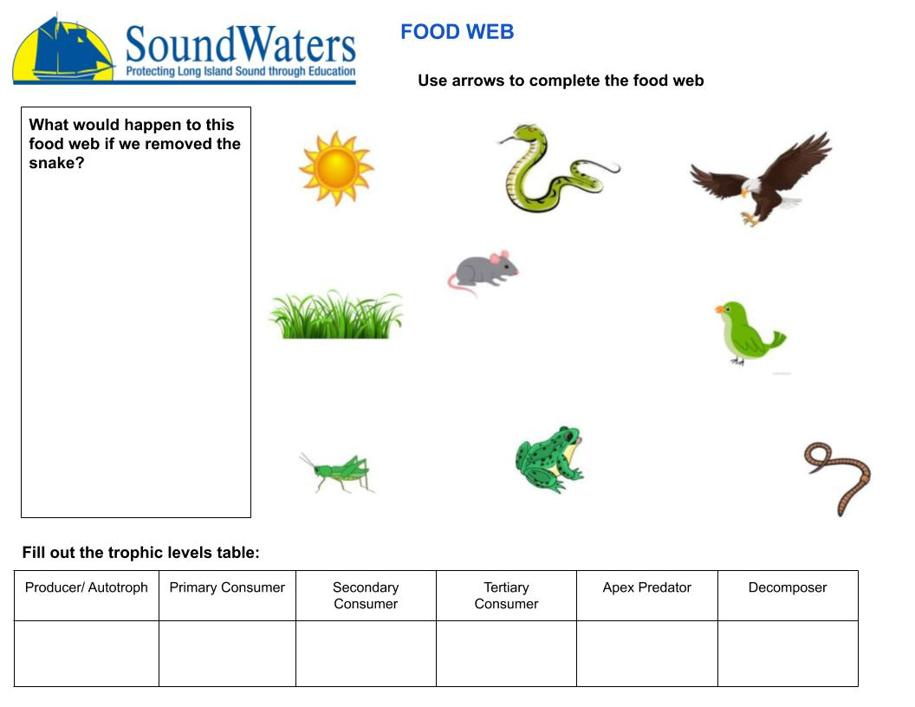
Write answer here
Write answer here
Write answer here
Write answer here
Write answer here
Write answer here
Write answer here
Notes:
I have attached 2 red arrows that you can copy and paste to create your food web. There are MANY arrows in this food web

