Slide 1
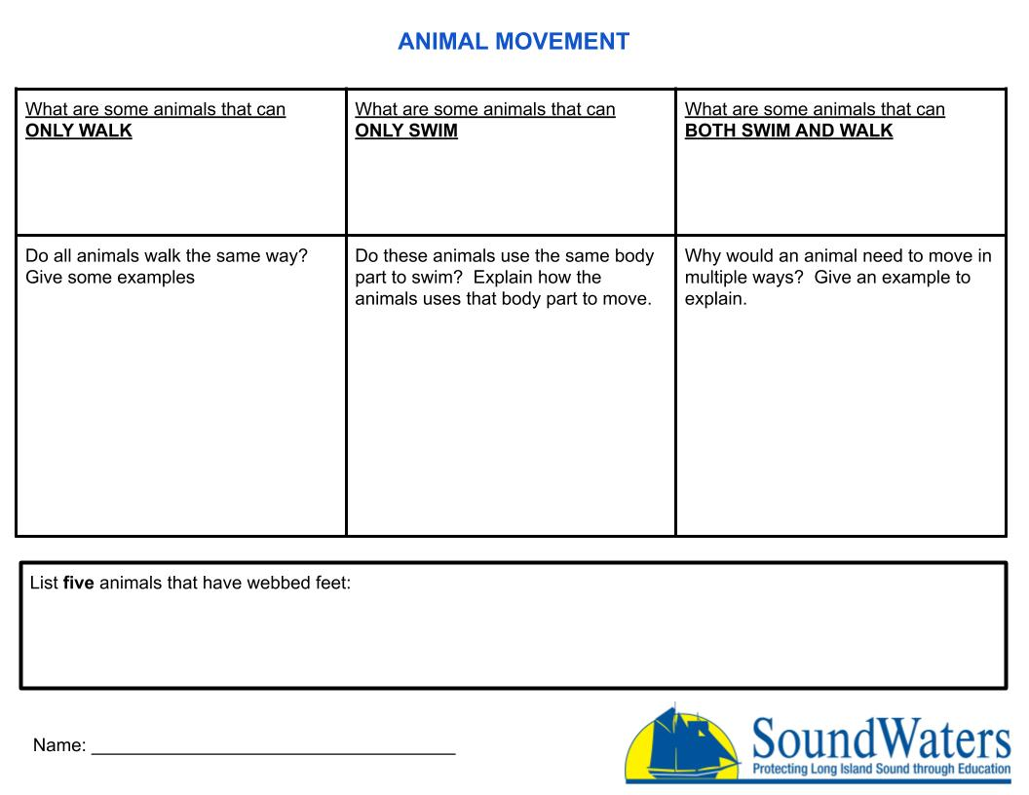
Type answer here
Type answer here
Type answer here
Type answer here
Type answer here
Type answer here
Type answer here
Type here

