Slide 1
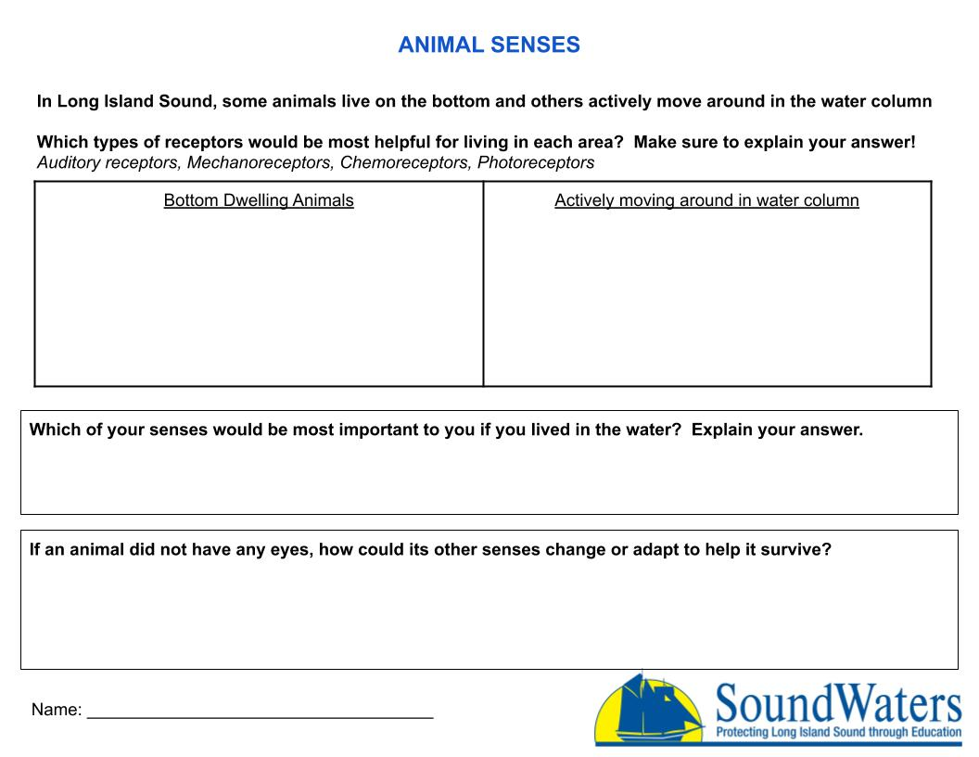
Write answer here
Write answer here
Write answer here
Write answer here

