Slide 1
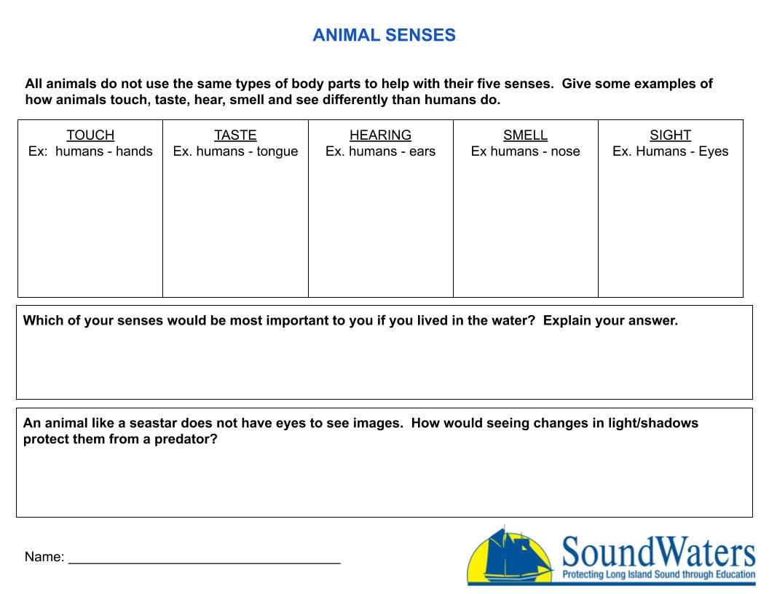
Type your answer
Type your answer
Type your answer
Type your answer
Type your answer
Type your answer
Type your answer
Type here

