Slide 1
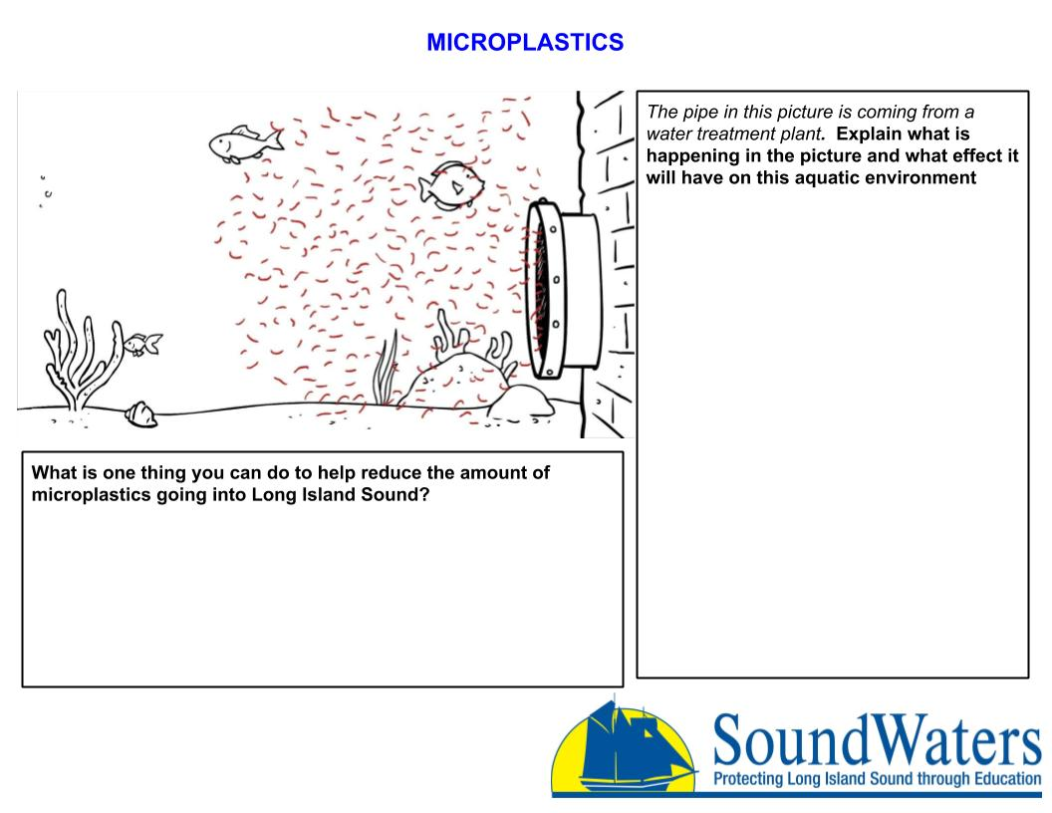
Write your answer here
Write your answer here

