Slide 1
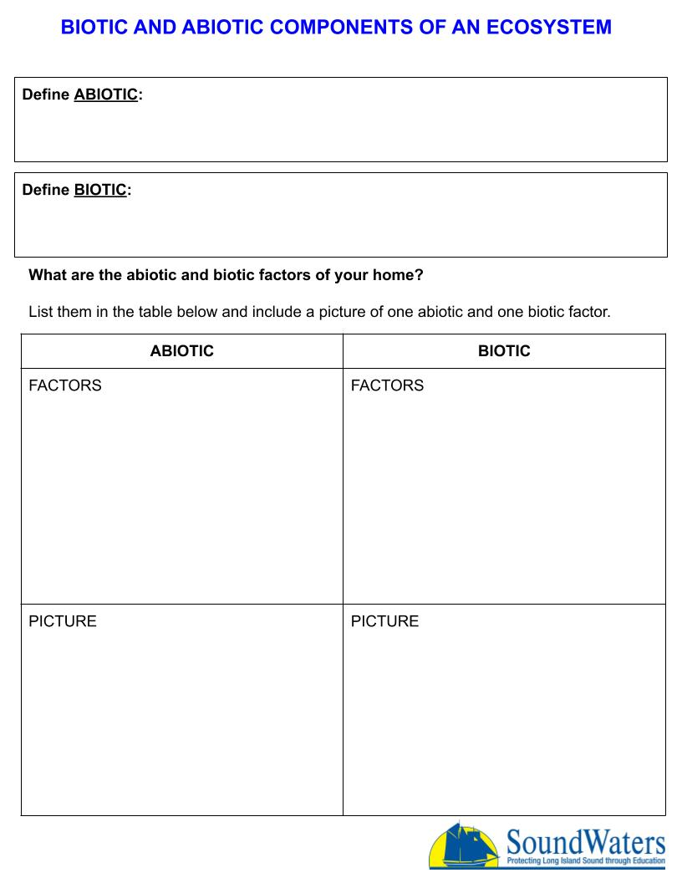
Answer here
Answer here
Answer here
Answer here
Picture here
Picture here

