Slide 1
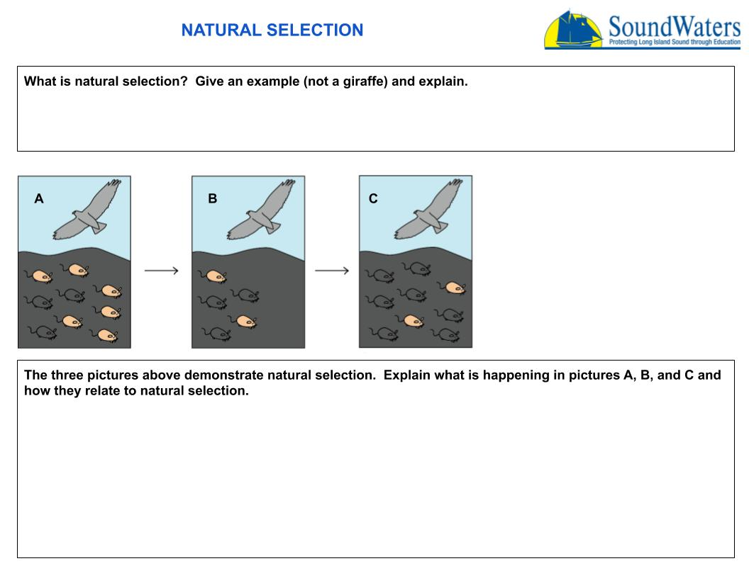
Answer here
Answer here

